Slide 1


Kyaw Zin Tun @ Wong Wun Kwint
2023-01-10

Slide 2

Outline
Executive Summary
Introduction
Methodology
Results
Conclusion
Appendix

Slide 3
Executive Summary
I use SpaceX open data api to get the data and perform the whole data pipeline to predicting whether the rocket re-landing will be success or not.
The SpaceX invest in rocket re-landing pays off as the number of success over the years keep increasing which is huge blow to rival companies to play catch-up in the field.

Slide 4
Introduction
This project is about SpaceX Falcon 9 first stage landing prediction.
By Knowing whether SpaceX could land its rocket or not, our company can bid against SpaceX for a rocket launch.
Because if SpaceX could land its rocket, it can cut its rocket price to 62 million dollars per launch which is far cheaper than average 165 million dollars of rival companies.

Slide 5

Section 1

Slide 6
Methodology
Executive Summary
Data collection methodology:
Request the SpaceX launch data with free REST api from SpaceX
Perform data wrangling
Process the data using pandas and numpy
Perform exploratory data analysis (EDA) using visualization and SQL
Perform interactive visual analytics using Folium and Plotly Dash
Perform predictive analysis using classification models
Train, evaluate different classification models to find the best model for prediction

Slide 7
Data Collection
First, I made a request to SpaceX API and extract relevant data.
Then, I transformed data to panda dataframe, included only Falcon 9 launches and replaced the missing values with mean value.
Finally, I saved the data into CSV file.
Include only Falcon 9
SpaceX API Request
Panda dataframe
Save to CSV
Remove irrelevant data
Replace missing value with mean

Slide 8
Data Collection – SpaceX API
On the left is my SpaceX API Data Collection Flow.
Since what we get back are ids, we had to subsequently request the real information with ids returned from above step.
https://github.com/kyawzinhtun7415/ibm-data-science/blob/98c32f7ec585de4f90218b392cef318b2616b457/jupyter-labs-spacex-data-collection-api.ipynb
API_call_spacex.api.json
pd.json_normalize
dataframe
Clean the data
Apply functions to get the data from id number
A new dataframe
Place your flowchart of SpaceX API calls here

Slide 9
Data Collection - Scraping
On the left is the flowchart of Falcon 9 launches records webscraped from Wikipedia
https://github.com/kyawzinhtun7415/ibm-data-science/blob/98c32f7ec585de4f90218b392cef318b2616b457/jupyter-labs-webscraping.ipynb
Falcon 9 Wiki page Url
Request
BeautifulSoup
Panda dataframe
df.to_csv
CSV

Slide 10
Data Wrangling
First, I did some exploratory data analysis to have an overview of data such as the number of rows and columns, or missing values, etc.
After that since we have to predict outcomes using machine learning, I standardize the 8 landing outcomes to 0 ( failure) and 1 ( success ) eventually.
https://github.com/kyawzinhtun7415/ibm-data-science/blob/98c32f7ec585de4f90218b392cef318b2616b457/labs-jupyter-spacex-Data%20wrangling.ipynb
Landing outcomes
CSV
Panda DataFrame
CSV
pd.read_csv
Standardize column
df.to_csv
Landing class

Slide 11
EDA with Data Visualization
I used the seaborn and matplotlib package of Python to visualize the charts.
I used the scatter plot to see the relationship of two variables, the bar chart to compare the number of variables and the line chart to see the relationship of the variable over time.
https://github.com/kyawzinhtun7415/ibm-data-science/blob/98c32f7ec585de4f90218b392cef318b2616b457/jupyter-labs-eda-dataviz.ipynb

Slide 12
EDA with SQL
I used SQL language to further perform my exploratory data analysis.
I find the average, count of payload_mass by launch site, booster version , etc.
I mostly use summary functions, groupby and where clauses to further specificities
https://github.com/kyawzinhtun7415/ibm-data-science/blob/98c32f7ec585de4f90218b392cef318b2616b457/jupyter-labs-eda-sql-coursera_sqllite.ipynb

Slide 13
Build an Interactive Map with Folium
I built an interactive map to see the launch sites on the map and to find relationship between launching site and outcome of the launch.
I used the Folium library of Python to build an interactive map.
Markers and circles are to mark the coordinates of the launch site and have pop-up, color parameter, etc.
The line function is mainly used to show the distance between the launch site and coastline, railway track, city ,etc to see their relationship on success of launches
https://github.com/kyawzinhtun7415/ibm-data-science/blob/98c32f7ec585de4f90218b392cef318b2616b457/lab_jupyter_launch_site_location.ipynb

Slide 14
Build a Dashboard with Plotly Dash
Summarize what plots/graphs and interactions you have added to a dashboard
I used Plotly Dash using Python and used pie chart and scatter plot of the library.
Users can interact with the dashboard to see the success all launch sites or specific launch site.
I used the pie chart to analyze the proportion of each launch site in terms of success and the scatter plot to analyze relationship between 3 variables.
https://github.com/kyawzinhtun7415/ibm-data-science/blob/98c32f7ec585de4f90218b392cef318b2616b457/spacex_dash_app.py

Slide 15
Predictive Analysis (Classification)
I tested 4 classification models (KNN, logistic regression, SVM, decision tree)
I used the same parameters to get the same result out of 4 models.
Out of 4 models, 3 models (KNN, logistic regression, SVM) have approximately the same training and test score so I applied cross-validation and domain-knowledge to choose the simpler model (logistic regression).
https://github.com/kyawzinhtun7415/ibm-data-science/blob/98c32f7ec585de4f90218b392cef318b2616b457/SpaceX_Machine%20Learning%20Prediction_Part_5.ipynb
Training data
Testing data
Compare the
models
Train the model
Score the model
Best model
Cross-validation
Model/Algorithm

Slide 16
Results
Exploratory data analysis results
Interactive analytics demo in screenshots
Predictive analysis results

Slide 17

Section 2

Slide 18
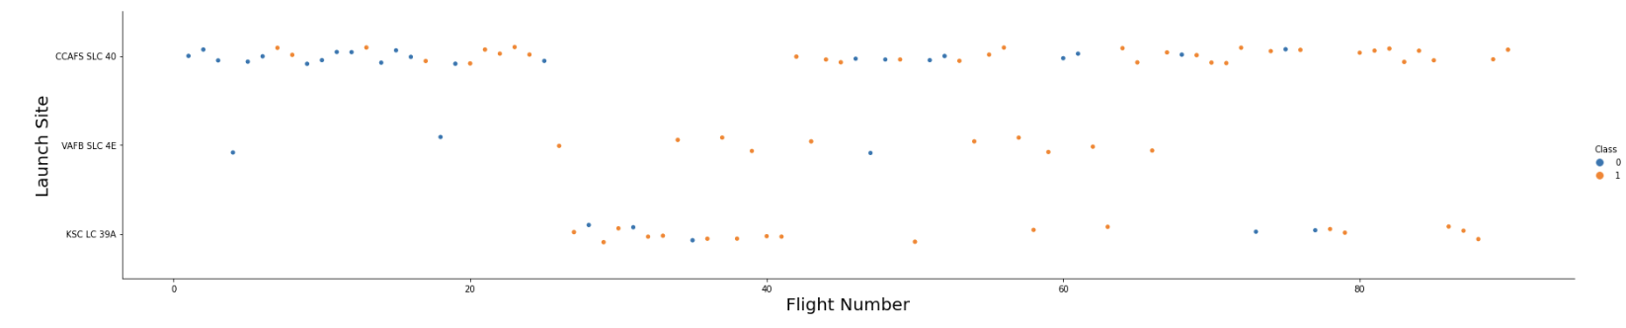
Flight Number vs. Launch Site
The plot shows the flight number, launch site and the outcome of the launch in one visualization.
We can see that the launch site ’CCAFS SLC 40’ is most used and approximately from flight number 80, the SpaceX launches have not failed once.

Slide 19
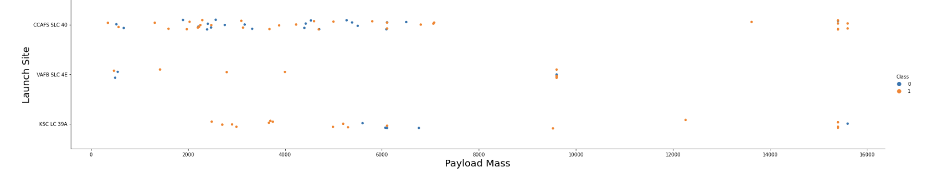
Payload vs. Launch Site
This plot shows the relationship between the payload and the launch site.
As we can see, there are no more payload mass heavier than 10,000 on launch site ‘VAFB SLC 4E’.
The plot cannot clearly describe a linear relationship between payload and launch site.

Slide 20
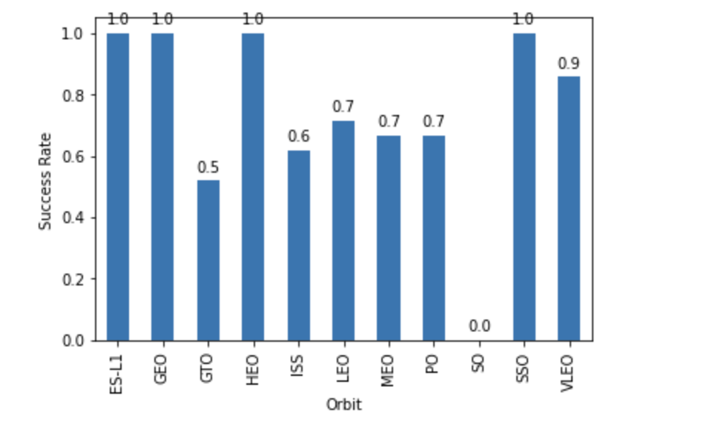
Success Rate vs. Orbit Type
This bar chart shows the various successful rocket launches by orbit type.
Both LEO and MEO have moderate success rate whereas HEO and GEO have 100% success rate.

Slide 21
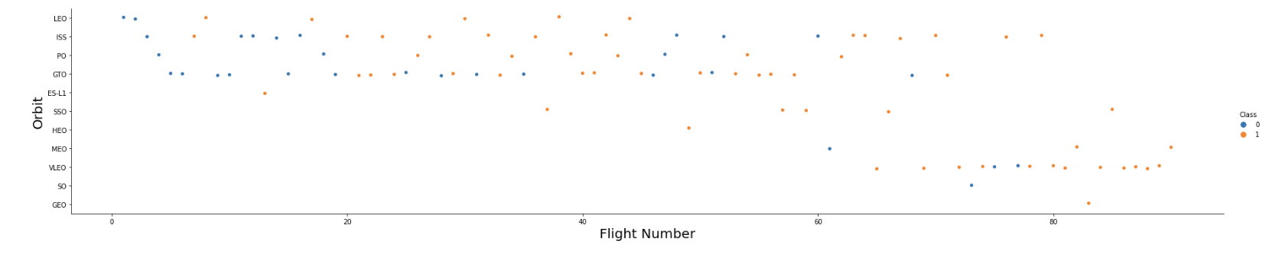
Flight Number vs. Orbit Type
The above scatter plot describes the relation between orbit type and flight number.
The later flight number approximately above 80 all encountered successes on all types of orbit types which mean that SpaceX rocket launch re-landing experiments have paid off.

Slide 22
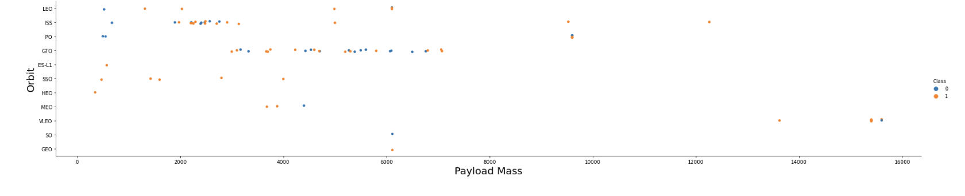
Payload vs. Orbit Type
The above diagram shows a scatter point of payload vs. orbit type.
We can see that the rocket launches using orbit SSO are successful 100%.
Other rocket launches to different types of orbit all have their own failures and successes.

Slide 23
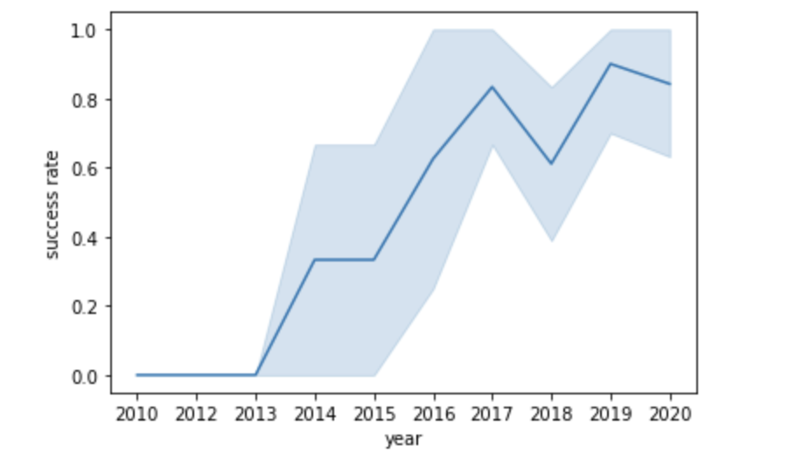
Launch Success Yearly Trend
The above shows a line chart of yearly average success rate
The success rate steadily increases as the year progresses except only a small dip in success rate in 2018.

Slide 24
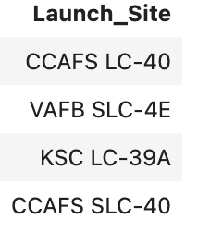
All Launch Site Names
The SQL query on the left displays the names of the unique launch sites.
The 4 locations are unique launch sites in the space mission.

Slide 25
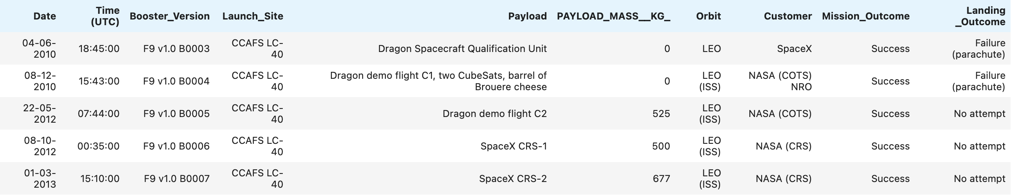
Launch Site Names Begin with 'CCA'
The above shows 5 records where launch sites begin with `CCA`
We can see all the columns associated with launch site names that begin with ‘CCA’.

Slide 26
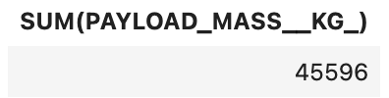
Total Payload Mass
The above shows the total payload carried by boosters from NASA

Slide 27
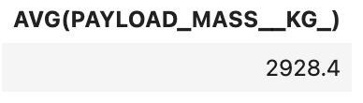
Average Payload Mass by F9 v1.1
The query shows the average payload mass carried by booster version F9 v1.1

Slide 28
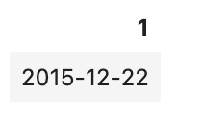
First Successful Ground Landing Date
The query shows the dates of the first successful landing outcome on ground pad

Slide 29
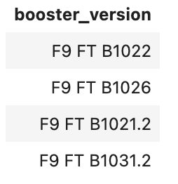
Successful Drone Ship Landing with Payload between 4000 and 6000
The diagram shows the names of boosters which have successfully landed on drone ship and had payload mass greater than 4000 but less than 6000

Slide 30
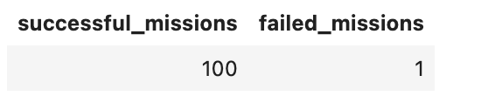
Total Number of Successful and Failure Mission Outcomes
The above shows the total number of successful and failure mission outcomes
The number of successful missions is 100 whereas only 1 mission is considered as fail.

Slide 31
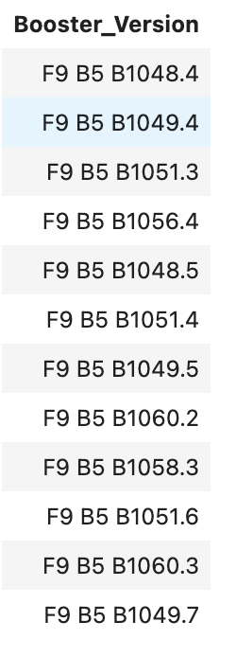
Boosters Carried Maximum Payload
These are the names of the booster which have carried the maximum payload mass
We can see that the maximum payload is carried by Falcon 9 B5 version only.

Slide 32
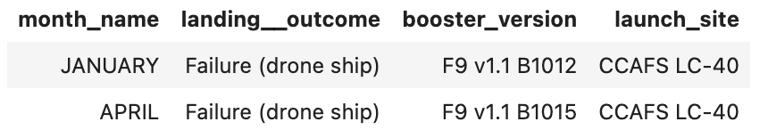
2015 Launch Records
The above shows the failed landing_outcomes in drone ship, their booster versions, and launch site names for in year 2015

Slide 33

Section 3

Slide 34
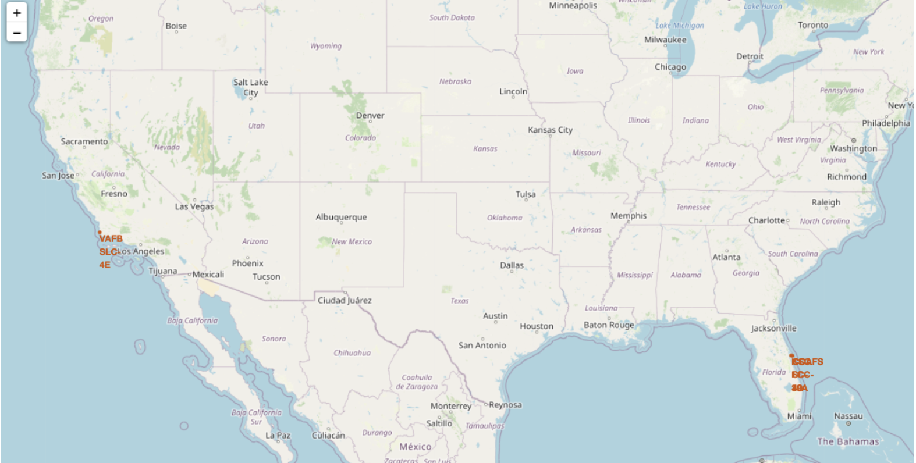
SpaceX Launch Sites
The launch sites can be divided into two places, east and west coast.

Slide 35
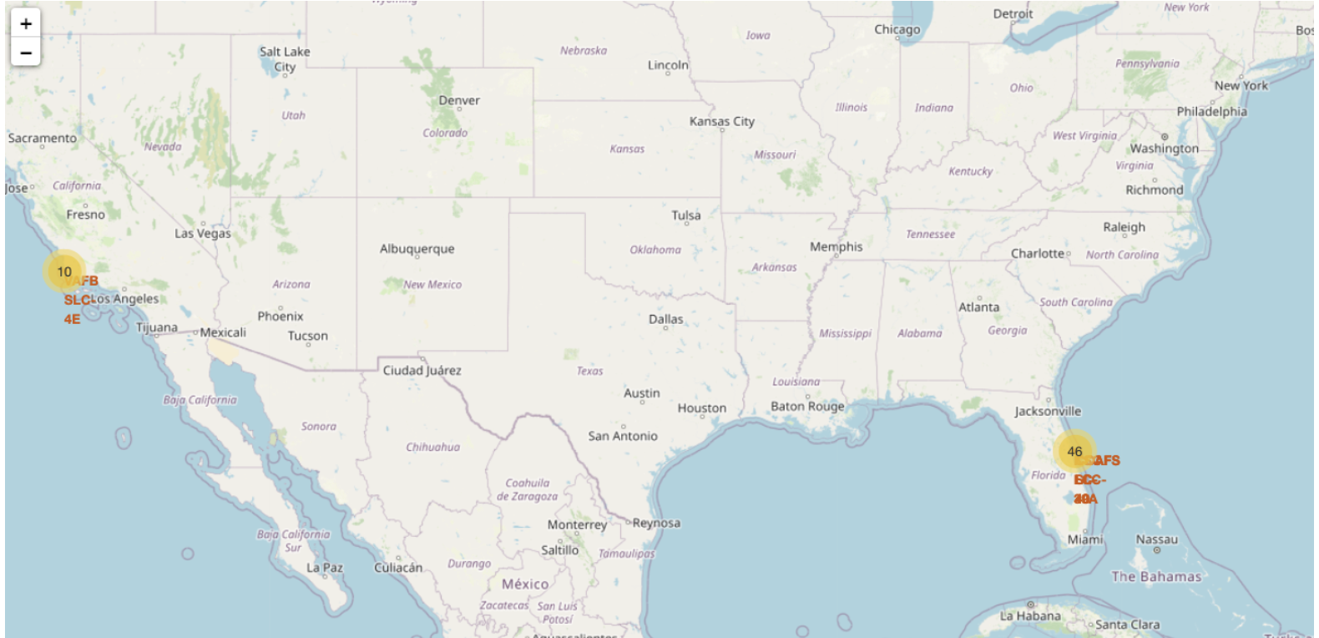
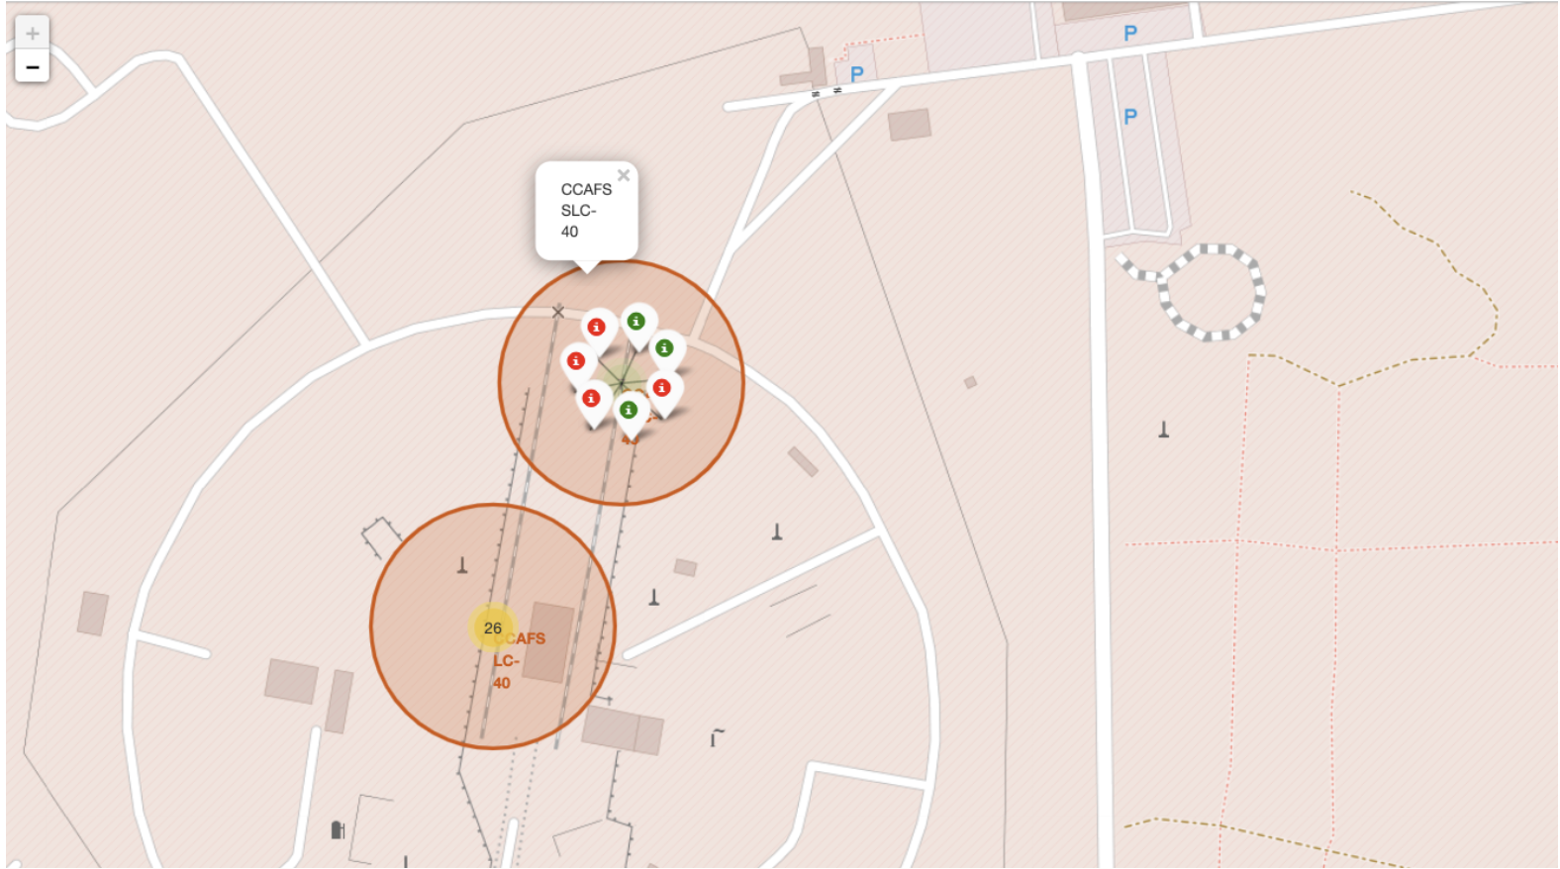
Success/failed launches for each site on the map
We can zoom out to see the number of sites and respective names.
If we zoom in, we can see the green and red marks , each representing success and failed launches on the map.

Slide 36
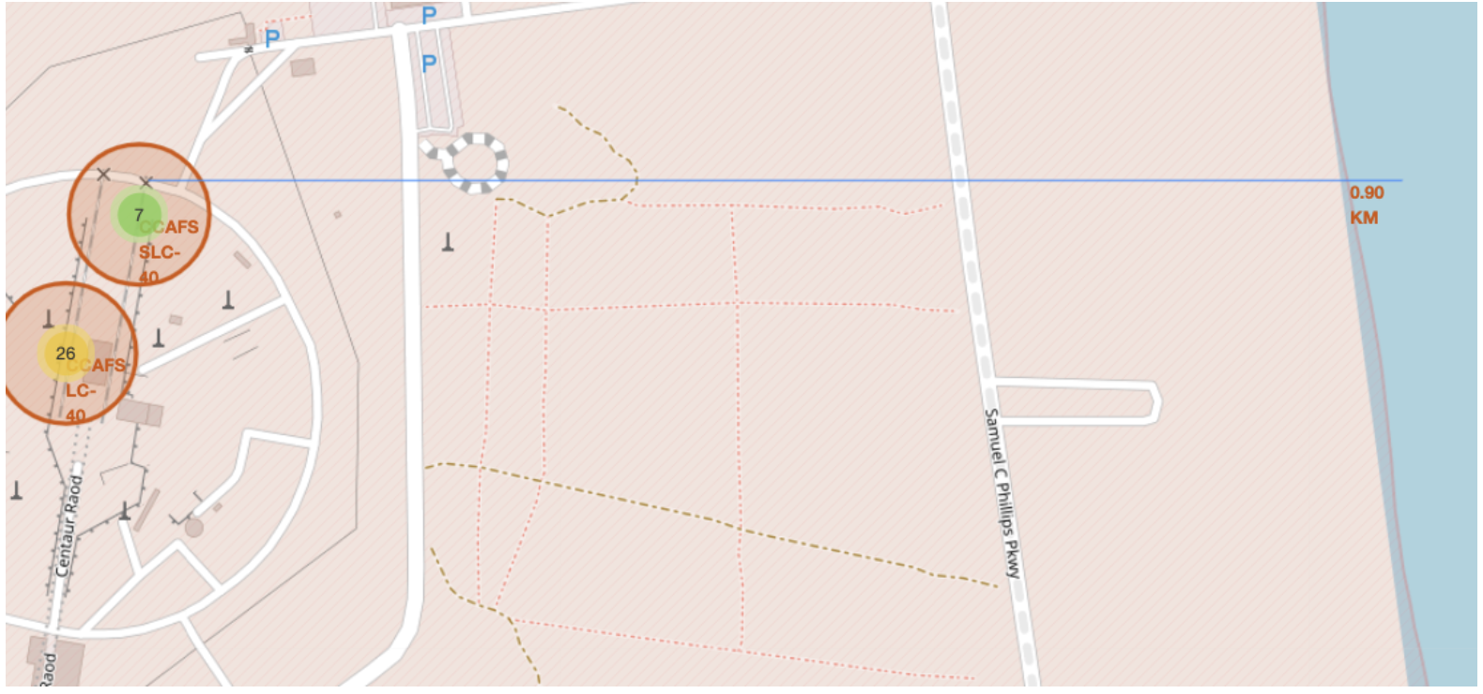
Distances between a launch site to the coastline
We can use the same type to measure distances to city, railway ,etc to see if the proximity to these areas has effect on mission success or failure.

Slide 37

Section 4

Slide 38
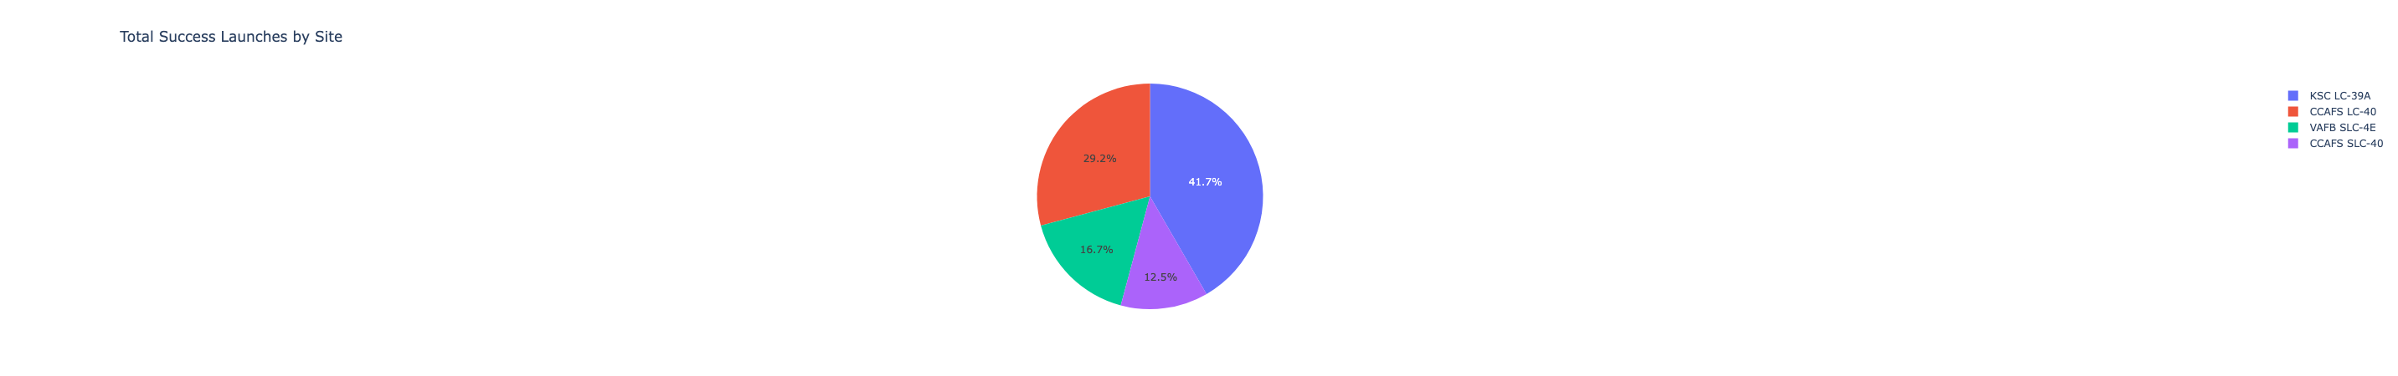
Launch success count for all sites
The launch from KSC LC-39A makes up about 40% of the launch success.
The runner-up is CCAFS LC-40 with 30% and the rest of the two are around 15%.

Slide 39
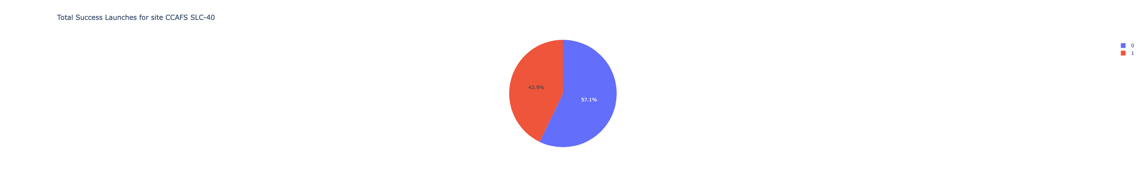
Launch site with highest launch success ratio
The Launch site CCAFS SLC-40 has the highest launch success ratio of 43%.

Slide 40
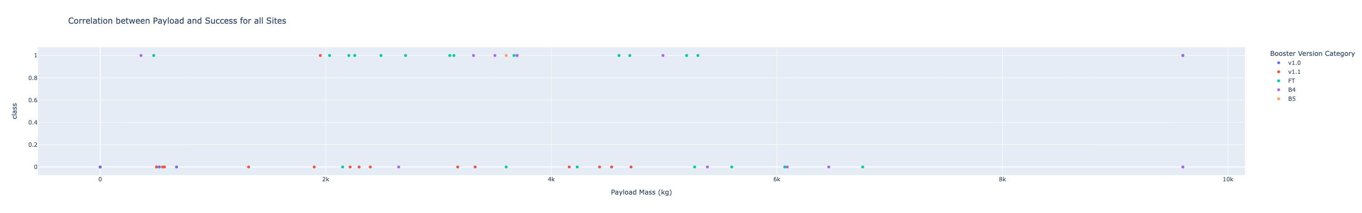
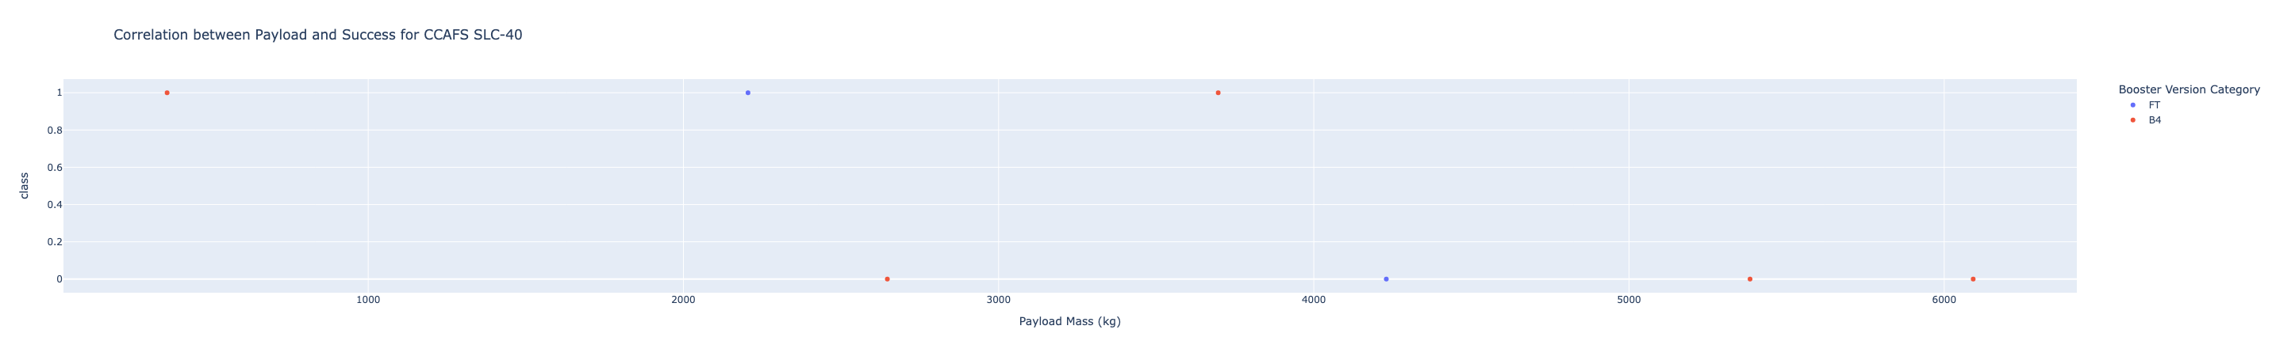
<Dashboard Screenshot 3>
The above plot shows the correlation between payload and success for all sites and we can observe that FT booster version has the most number of successes.
Below is an example of the same correlation but for one site only.

Slide 41

Section 5

Slide 42
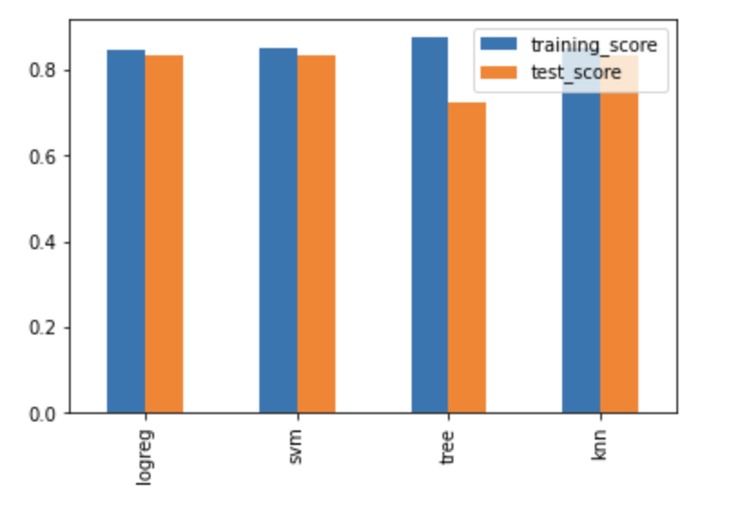
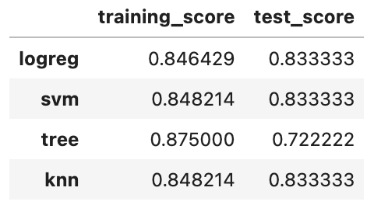
Classification Accuracy
As we can see above, it is difficult to choose between one of the three models (logistic regression, support vector machine, k-nearest neighbors) as they have the same classification accuracy.

Slide 43
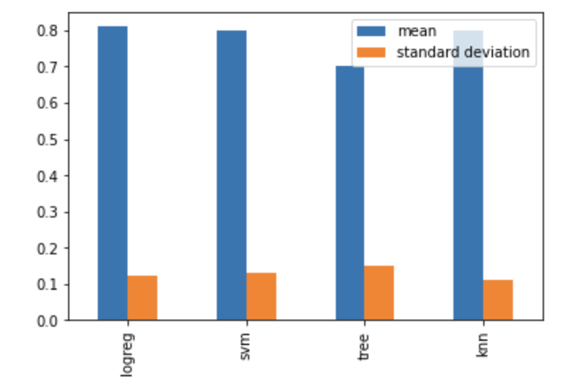
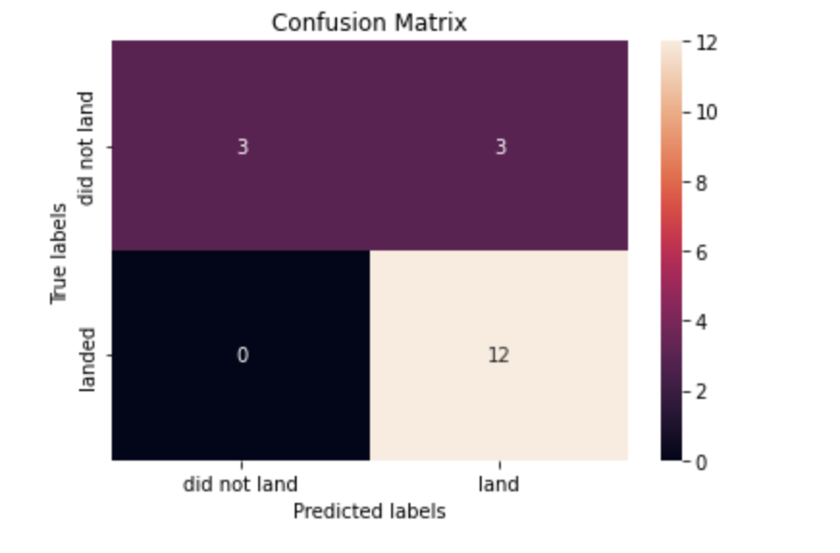
Confusion Matrix
The above is my 10-fold cross-validation result. The blue bar is the mean of the scores and the orange one is the standard deviation of the scores.
Therefore, after considering mean, standard deviation, complexity, I chose logistic regression as this classification can be solved by logistic regression which contains only 0 and 1.

Slide 44
Conclusions
SpaceX invest in rocket relanding experiment pays off in the end.
We can use logistic regression to predict whether SpaceX will land their rocket or not.
SpaceX can use CCAFS SLC-40 launch site to increase their launch success.

Slide 45
Appendix

Slide 46


